Slide 1
Object Detection Fundamentals
Instructor: Stephin Rachel Thomas
March 19, 2026

Slide 2
Today’s Topics
Introduction to Object Detection
Traditional Object Detection
Deep Learning in Object Detection
Detection Models Vs Classification models
R CNN
YOLO
SSD

Slide 3
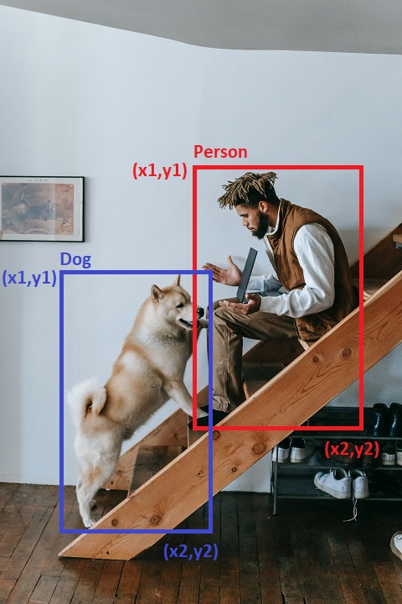
Introduction to Object Detection
Object detection is a crucial aspect of computer vision, where the goal is to identify and locate objects in images or videos.
It's a step beyond image classification by not only categorizing the objects but also indicating their location and scale within the scene.
Common applications include surveillance, autonomous vehicles, and facial recognition.

Slide 4
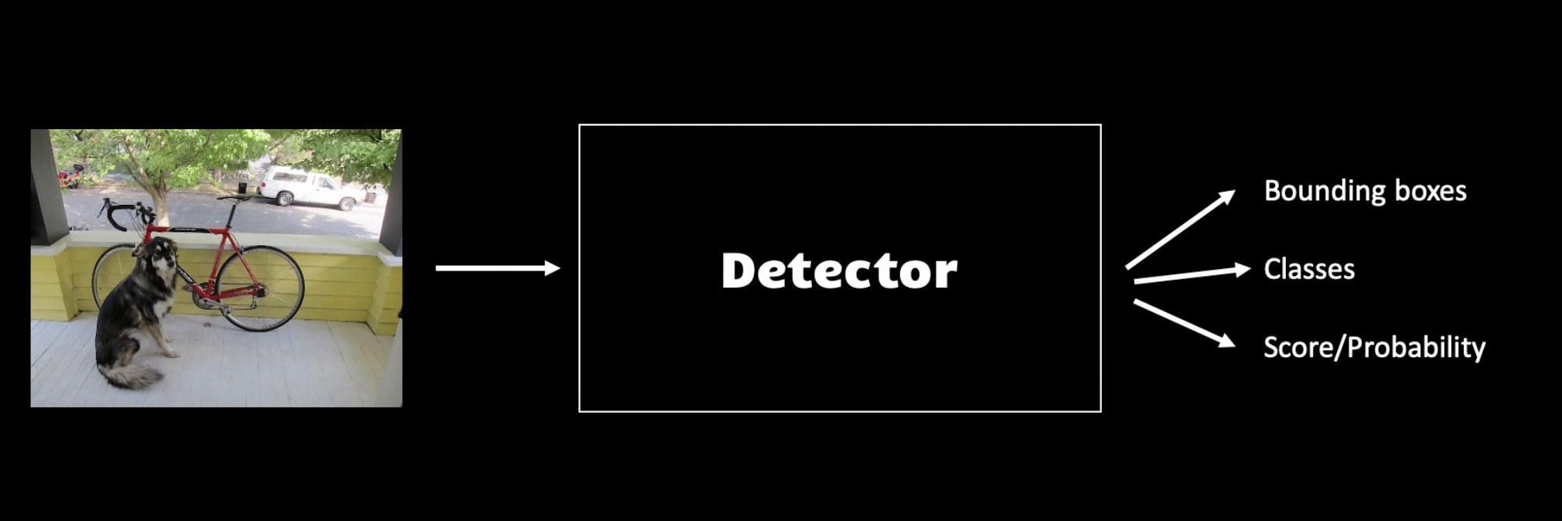
The Evolution of Object Detection
The field of object detection has transitioned from manual feature extraction and simple classifiers to sophisticated deep learning models. Early methods, like template matching and feature-based approaches, were limited by their rigidity and inability to handle variations in scale, viewpoint, and illumination. The advent of deep learning brought about a paradigm shift, leveraging neural networks to automatically learn features directly from data.

Slide 5
Traditional Object Detection: Overview
In traditional object detection, feature extraction was a critical step. Techniques like SIFT (Scale-Invariant Feature Transform) and HOG (Histogram of Oriented Gradients) were widely used to describe local image appearances and shapes. The sliding window method was then applied to systematically move across the image at various scales and extract these features. A classifier like SVM (Support Vector Machine) would then determine whether each window contains the object of interest.
Sliding window with image pyramid

Slide 6
Traditional Object Detection: Key Concepts
Descriptors play a crucial role in defining the characteristics of objects. For example, SIFT identifies and describes local features in images, invariant to scaling and rotation, making it effective for matching different images of the same object.
The Histogram of Oriented Gradients (HOG) captures the structure of objects by aggregating local gradient directions or edge orientations.
The sliding window technique involves moving a window of various sizes across the image, extracting features at each position, and using a classifier like SVM to label each window as containing the object or not.

Slide 7
Limitations of Traditional Object Detection
Traditional methods struggled with variations in object scale, orientation, and lighting conditions. The need for handcrafted features limited their adaptability and effectiveness, as these features might not generalize well across diverse scenarios. Additionally, the computational inefficiency of sliding windows, particularly in high-resolution images, posed significant challenges for real-time applications.

Slide 8
Transition to Deep Learning
The advent of deep learning marked a transformative change in object detection. Neural networks, particularly Convolutional Neural Networks (CNNs), allowed for automatic feature extraction, learning complex patterns directly from data. This shift not only improved detection accuracy but also enabled the systems to adapt to a wide range of objects and scenes, overcoming many limitations of traditional methods.

Slide 9
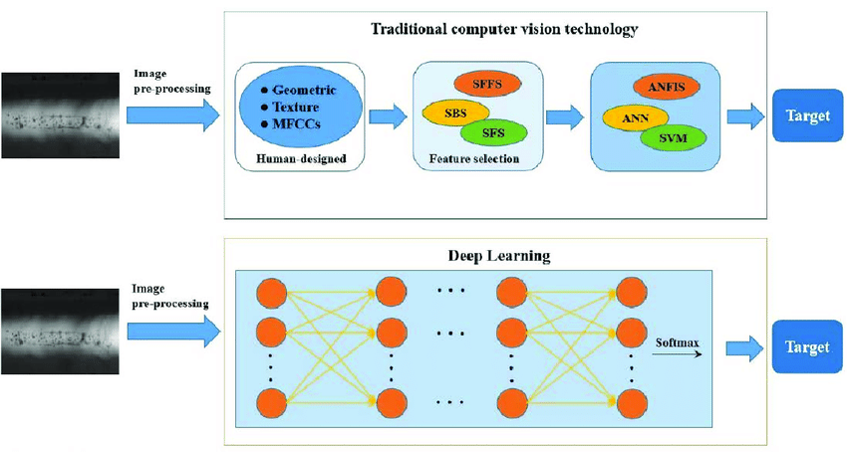
Transition to Deep Learning

Slide 10

Deep Learning in Object Detection: Feature Extraction
In deep learning-based object detection, CNNs play a vital role in feature extraction. Layers of a CNN automatically learn to detect edges, textures, and eventually complex patterns as the network deepens. This hierarchical feature extraction process enables the model to learn a robust representation of objects, making it adept at handling variations in appearance and viewpoint.

Slide 11
Deep Learning in Object Detection: Detection Head
The detection head of a deep learning model is responsible for predicting object classes and locations. Unlike classification models that output class probabilities, detection models also predict bounding boxes around objects. This involves not only identifying 'what' is present in an image but also 'where' it is.
Techniques like Region Proposal Networks (RPN) in Faster R-CNN and grid-based approaches in YOLO (You Only Look Once) exemplify different strategies for this task.

Slide 12
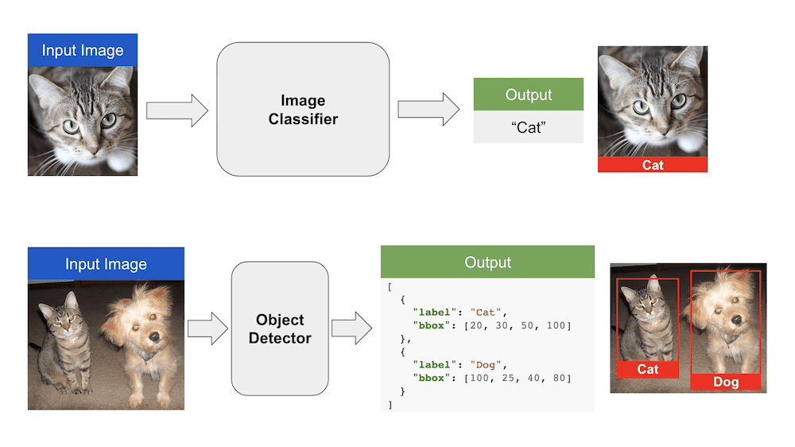
Outputs of Detection Models vs. Classification Models
Detection models differ from classification models in their outputs. While classification models output a probability distribution across different classes for the whole image, detection models provide class probabilities, bounding box coordinates, and sometimes confidence scores for multiple objects within the image. This distinction is crucial as it allows detection models to localize multiple objects and their scales within a single image, offering a more detailed understanding of the scene.

Slide 13
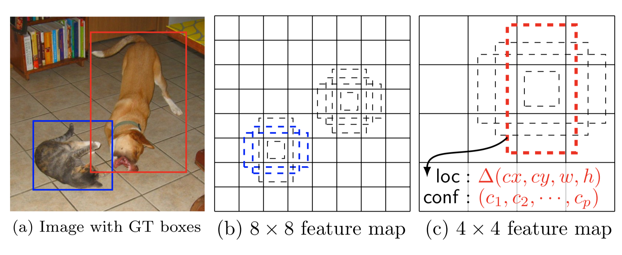
Types of Detection Heads: Anchor-Based
Anchor-based detection heads use predefined bounding boxes (anchors) of various sizes and aspect ratios to detect objects. Techniques like Faster R-CNN generate region proposals based on these anchors, adjusting them to better fit the objects. This method is beneficial for detecting objects of different shapes and sizes but can be computationally intensive due to the large number of proposals.

Slide 14
Types of Detection Heads: Anchorless
Anchorless detection heads, seen in models like CornerNet and CenterNet, do away with predefined anchors. Instead, they directly predict the corners or centers of objects. This approach simplifies the detection pipeline and can reduce computational complexity. However, it might require more sophisticated training strategies to achieve the precision offered by anchor-based methods.

Slide 15
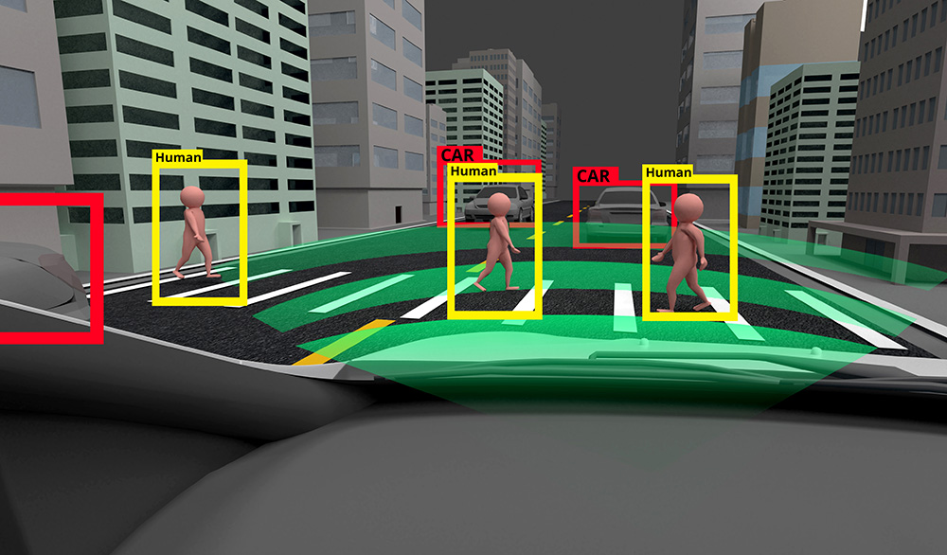
Case Studies and Applications: Real-World Examples
Object detection has vast applications in today’s world. In autonomous vehicles, it's used for pedestrian and vehicle detection to navigate safely. In retail, it assists in inventory management through product recognition. In healthcare, it aids in identifying anomalies in medical imaging. These real-world examples demonstrate the practical utility and transformative potential of object detection technology.

Slide 16
Case Studies and Applications: Industry Use-Cases
In industries like security and surveillance, object detection plays a crucial role in monitoring and threat detection. In agriculture, it helps in crop analysis and yield prediction. In manufacturing, it's used for quality control by detecting defects. These use-cases highlight the versatility of object detection in providing solutions across various sectors.

Slide 17
Advanced Topics in Object Detection: R-CNNs and Beyond
The development of R-CNN (Region-based CNN) and its successors, Fast R-CNN and Faster R-CNN, marked significant advancements in object detection. These models improved accuracy and speed by integrating region proposal networks with deep learning. Following these, methods like SSD (Single Shot MultiBox Detector) and YOLO (You Only Look Once) further optimized the process, enabling real-time detection by eliminating the need for separate region proposal stages.

Slide 18
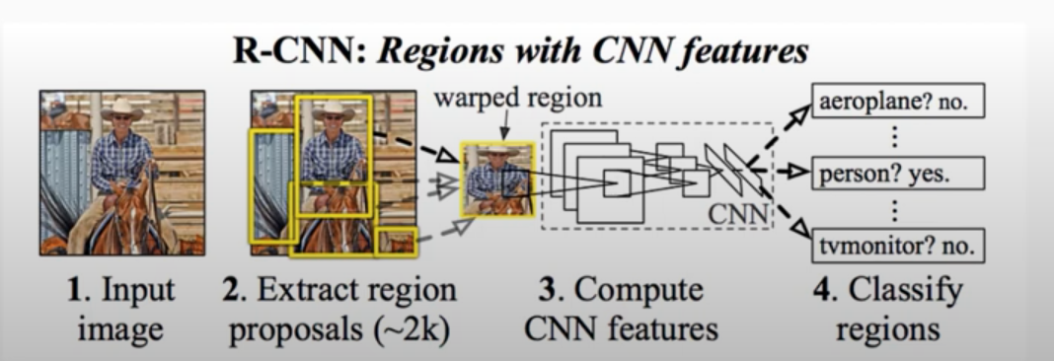
R-CNN (Region-based CNN)
R-CNN solves exhaustive search performed by sliding window, by proposing bounding boxes, and passing these extracted boxes to an image classifier (Eg: ImageNet)
Selective search algorithm is used for making bounding box proposals

Slide 19
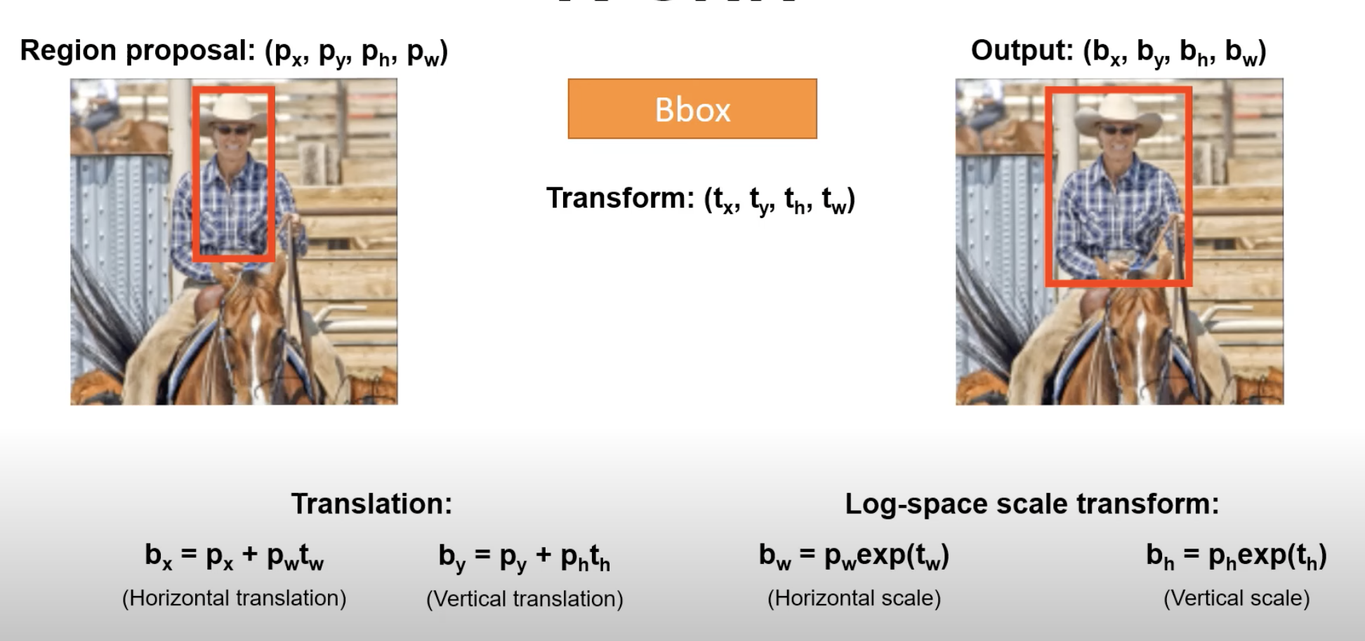
Calculating Bounding Box in R-CNN

Slide 20
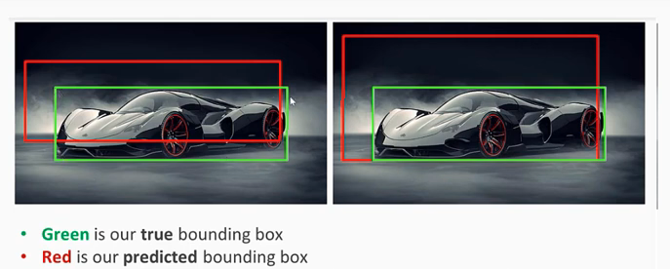
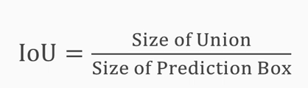
Intersection Over Union (IOU) Metric
IOU metric is used to determine good bounding box
Typically, an IoU over 0.5 is considered acceptable
The higher the IoU, the better the prediction
It is a measure of overlap

Slide 21
Advanced Topics: Single Shot Detectors (SSD) and YOLO
Single Shot Detectors (SSD) and YOLO (You Only Look Once) represent a leap in object detection, focusing on speed and efficiency. SSD discretizes the output space of bounding boxes into a set of default boxes over different aspect ratios and scales. YOLO, on the other hand, divides the image into a grid, and each grid cell predicts bounding boxes and class probabilities directly. These methods are renowned for their ability to detect objects in real-time.

Slide 22
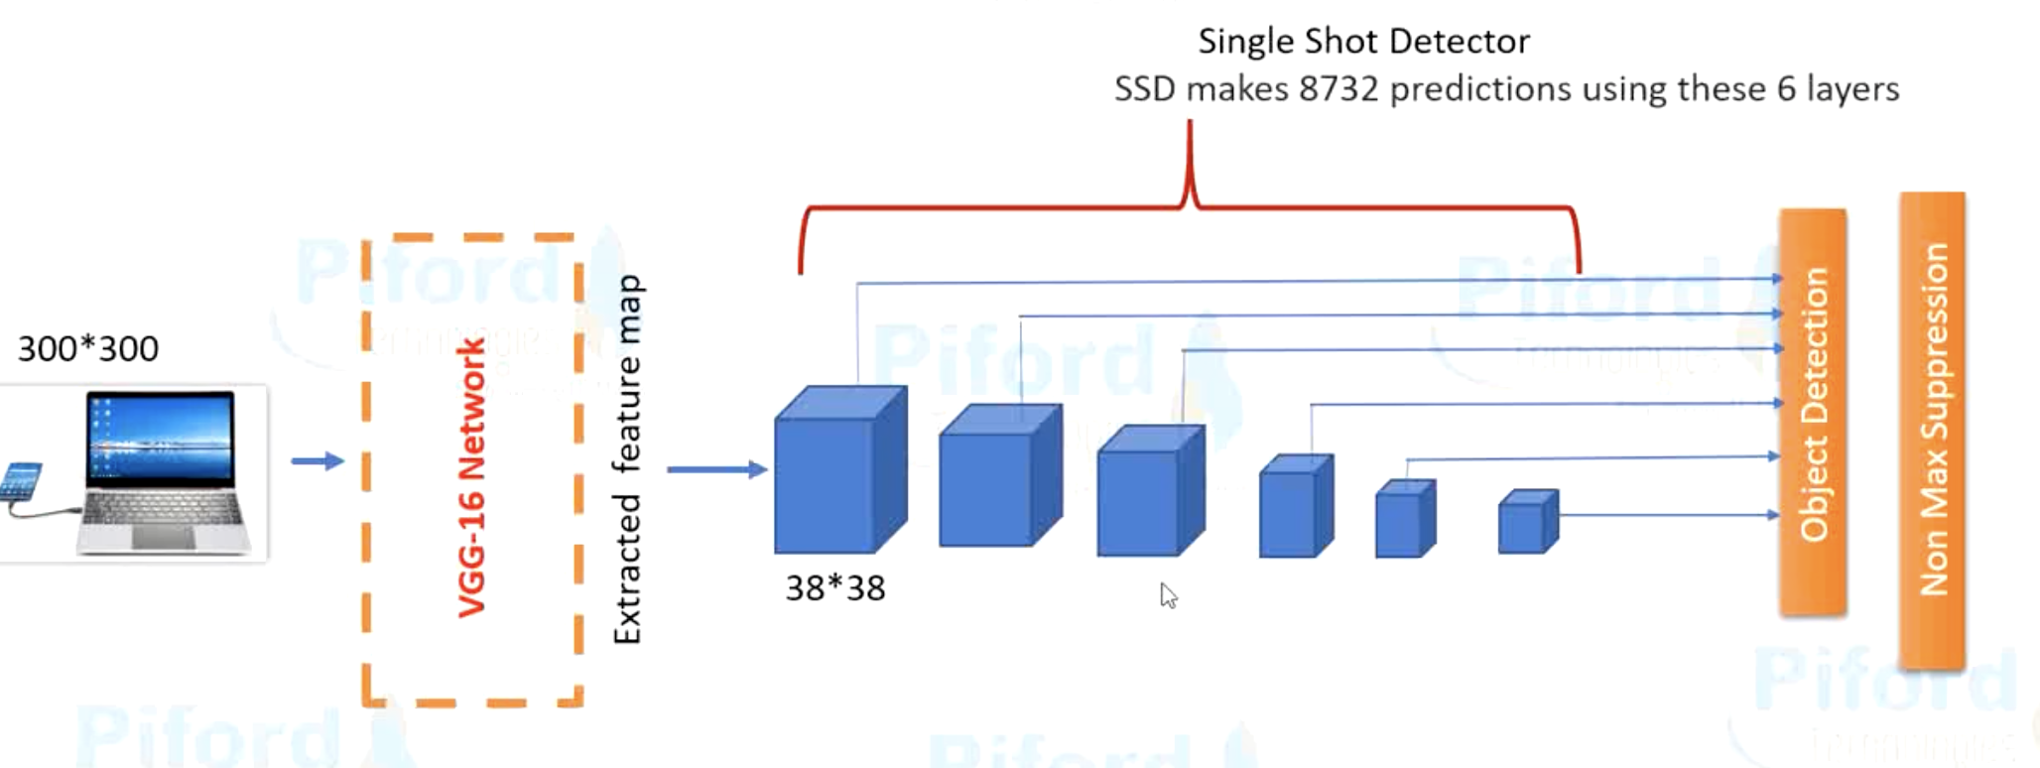
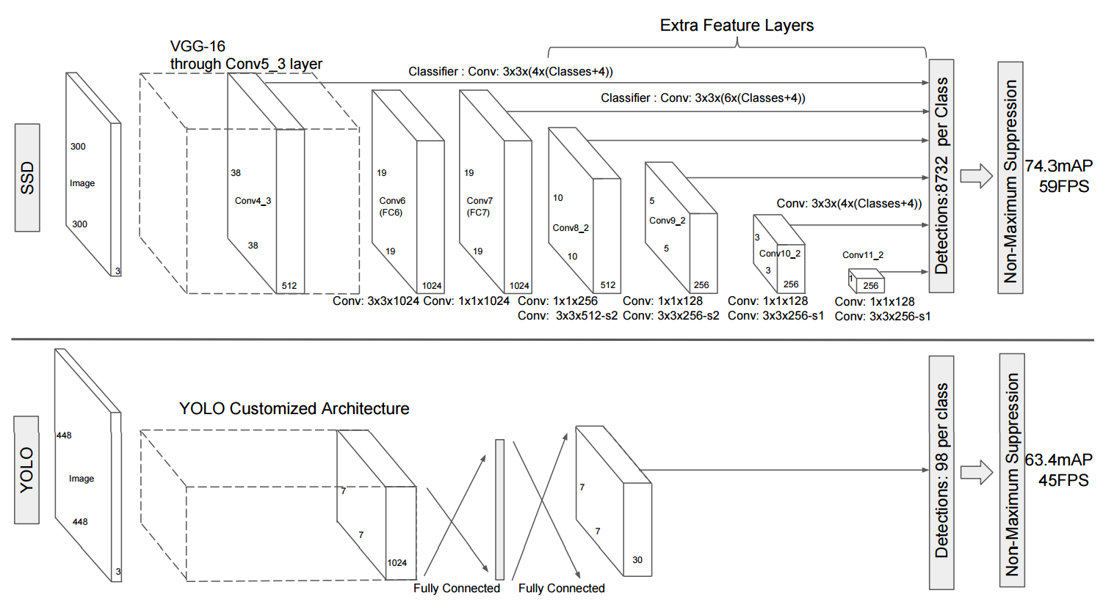
SSD vs YOLO

Slide 23
Single Shot Detectors (SSD)
Single Shot: Unlike region-based methods that require multiple stages, SSD performs object detection in a single pass through the network, making it very fast.
Multi-Scale Feature Maps: SSD uses multiple feature maps at different scales to detect objects of various sizes. This allows the model to handle objects at different resolutions effectively.
Default Boxes: SSD introduces the concept of default boxes (also known as anchor boxes) with different aspect ratios and scales at each feature map cell. These default boxes act as reference points for predicting bounding boxes.
Bounding Box Prediction: For each default box, SSD predicts the offsets to the ground truth bounding box and the confidence scores for each class. This results in a set of bounding boxes with associated class probabilities.
Non-Maximum Suppression (NMS): Similar to YOLO, SSD applies NMS to filter out overlapping bounding boxes and keep only the most confident detections.

Slide 24
You Only Look Once (YOLO)
Single Forward Pass: Unlike traditional methods that apply the model to multiple regions of the image, YOLO processes the entire image in a single forward pass. This makes it extremely fast.
Grid Division: YOLO divides the input image into multiple grids. Each grid cell is responsible for predicting a fixed number of bounding boxes and their corresponding confidence scores.
Bounding Box Prediction: For each grid cell, YOLO predicts multiple bounding boxes, each with a confidence score that indicates the likelihood of an object being present and the accuracy of the bounding box.
Class Prediction: Along with bounding boxes, YOLO predicts class probabilities for each grid cell, indicating which object class (e.g., person, car, dog) is present.
Non-Maximum Suppression (NMS): To reduce redundant detections, YOLO applies NMS to keep only the most confident bounding boxes for each detected object.

Slide 25
Challenges in Object Detection
Despite advancements, object detection faces challenges like detecting small or occluded objects, handling diverse and complex backgrounds, and dealing with varying lighting conditions. Balancing precision and recall, especially in crowded scenes, remains a critical issue. There's also the challenge of computational resource requirements for training and deploying sophisticated models.

Slide 26
Future Perspectives and Emerging Technologies
The future of object detection lies in integrating it with emerging technologies like augmented reality (AR) and the Internet of Things (IoT). The development of low-power, high-performance models is essential for edge computing applications. Furthermore, incorporating advances in artificial intelligence, such as explainable AI and reinforcement learning, can lead to more robust and intelligent object detection systems that understand context and interactions within a scene.

Slide 27
Conclusion and Key Takeaways
In conclusion, object detection has evolved from traditional methods to advanced deep learning techniques, significantly enhancing its capabilities and applications. The field continues to grow, driven by ongoing research and technological advancements. Key takeaways include the importance of robust feature extraction, the efficiency gains from modern detection methods, and the challenges and opportunities that lie ahead in this dynamic and impactful area of computer vision.

